Slide 1
Microsoft Azure Workshop
Welcome
David.Griswtood@microsoft.com
Jamie.Dalton@microsoft.com
Bianca Furtuna bifurt@microsoft.com
Jonathan Collinge jocollin@microsoft.com
#UKDXAzure

Slide 2
Agenda
9:30am Registration opens
10am Workshop starts, with breaks for coffee and lunch
2pm Networking and informal one to one discussions
3pm Machine Learning and DevOps ‘workshops’
4pm Close
The Road to the Modern Cloud
Micro-services in Azure
DevOps on Azure
The Internet of Things and Azure
The Azure data platform + machine learning

Slide 3


The Road to the modern cloud
David Gristwood

Slide 4
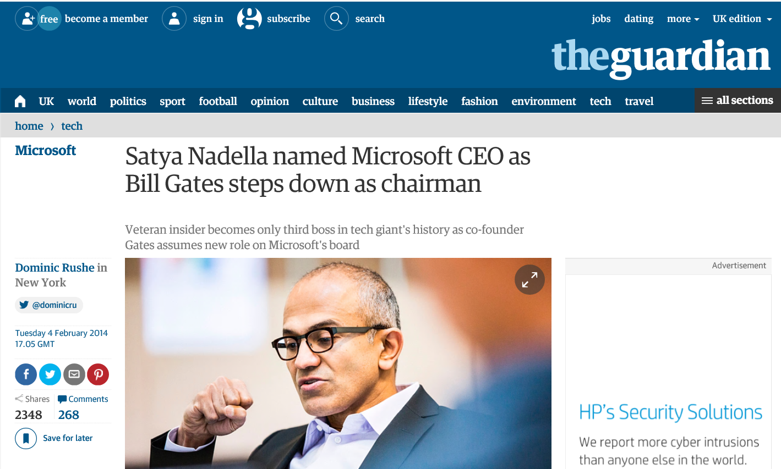
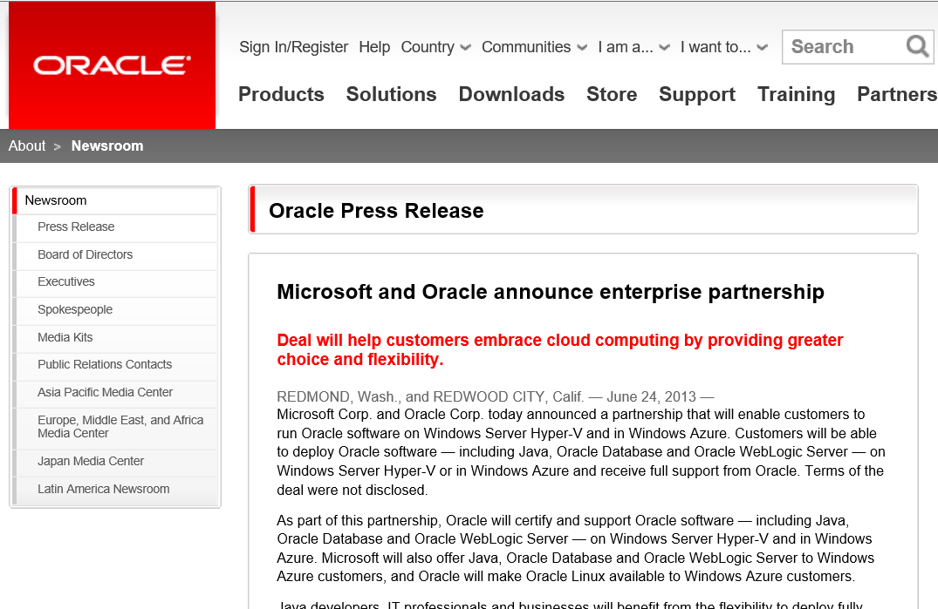
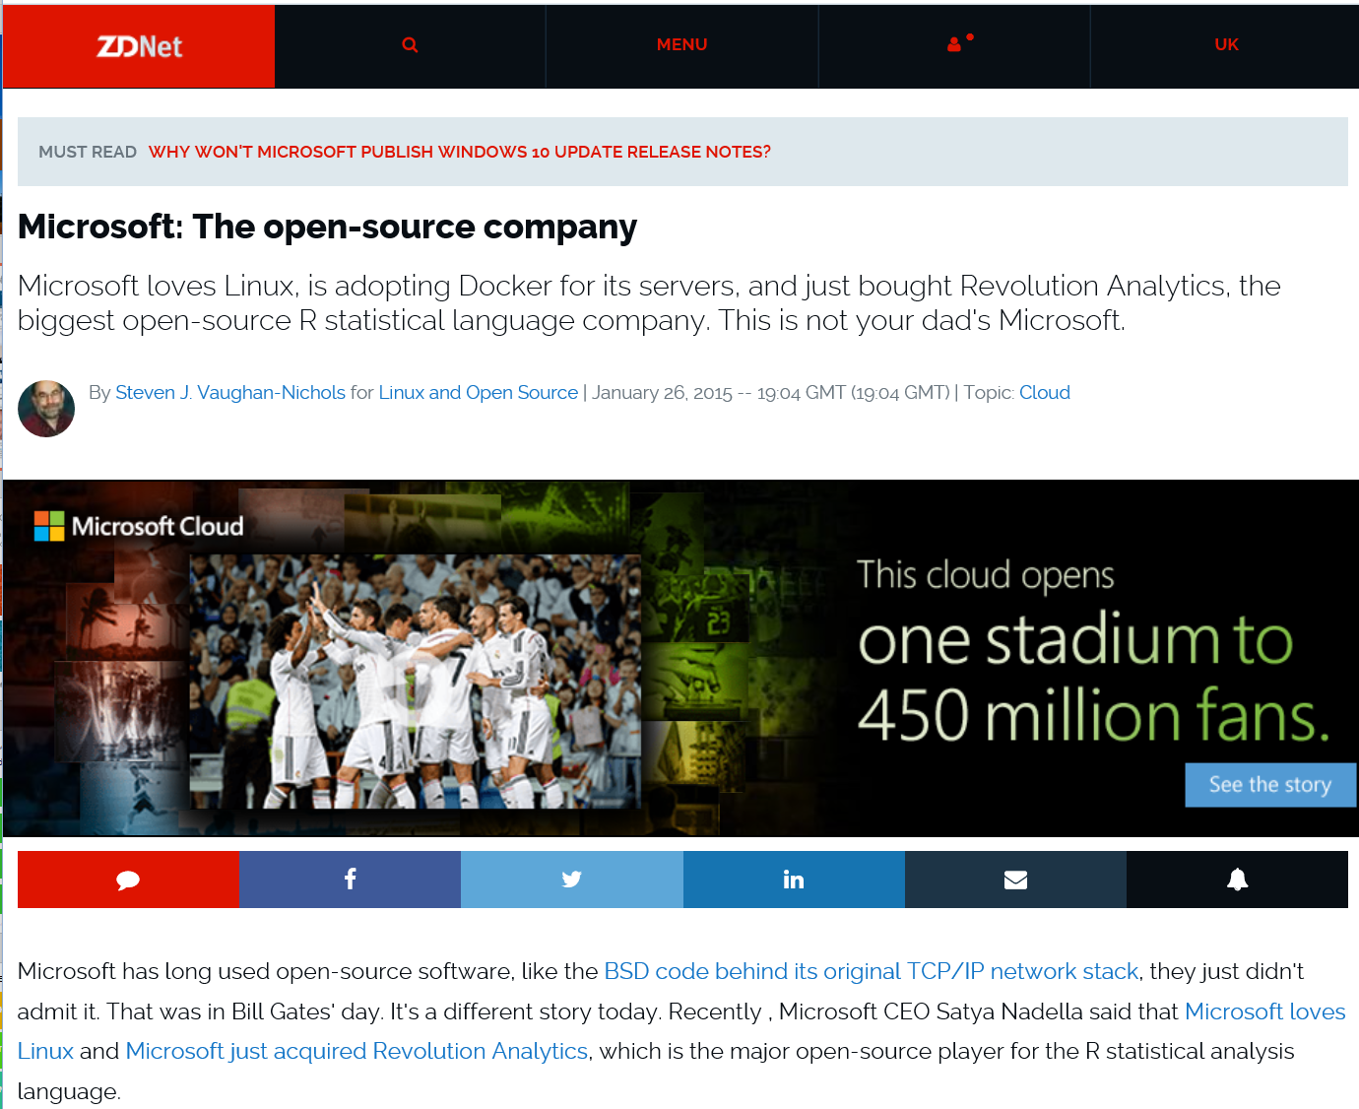
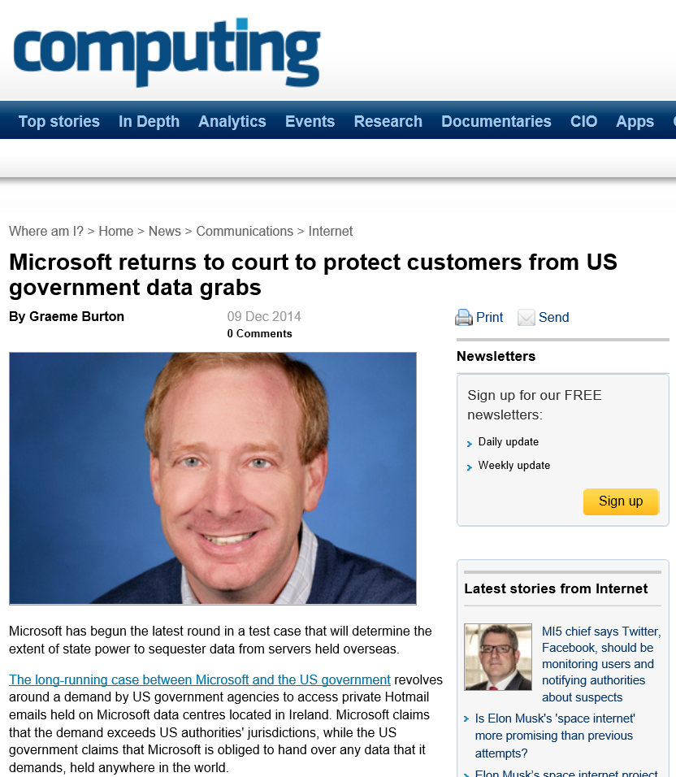
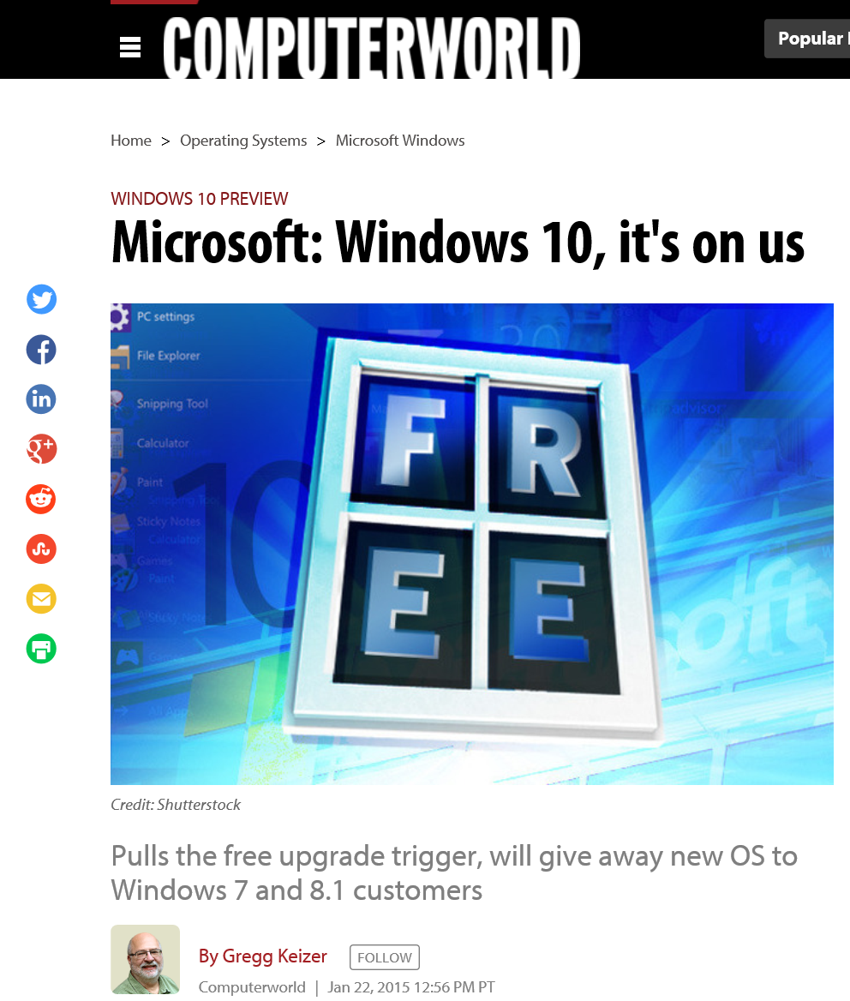
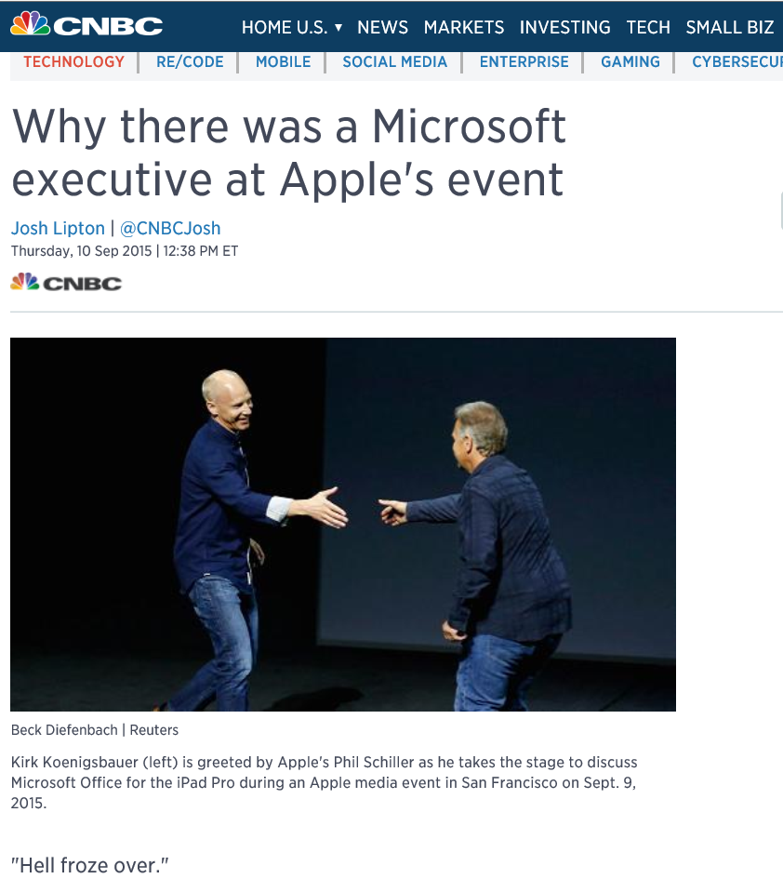
Microsoft over the last few years … the only constant is CHANGE

Slide 5



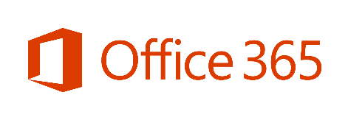










Microsoft mission
Microsoft Strategy
Empower every person and every organization on the planet to achieve more
Build best-in-class platforms and productivity services for a mobile-first, cloud-first world
Reinvent productivity & business processes
Microsoft Azure
Build the intelligent cloud platform
Create more personal computing

Slide 6
Microsoft Azure
The cloud platform
built for business and
innovation

Slide 7

Why are people moving to the Cloud?
“Cloud is a given. CIOs no longer ask whether they should use cloud, but rather how.”
QUICK & EASY
Deploy in minutes
ELASTIC SCALE
Scale/burst to your needs
ECONOMICS
No upfront costs
CREATE VALUE
Engage customers with Web/Mobile apps
Create your own Internet of Things (IoT)
Shorter development cycles
Building blocks allow quick value (and failure)
No long-term commitments
No wasted, under-used capacity
Unlock insights with Big Data & ML
Global Coverage for global scale
….and to quote real customers:
“I am a Start-up, I have no option”
“Current hoster is too expensive”
“We need to get our skunkworks project launched”
“We hate IT”
“We need to gain Control from IT”
“It’s cool to do cloud”
$127bn spend on public Cloud by 2018
“My customer is demanding it”
“New entrants in marketplace cheaper”
“Cloud to service long tail”
“Headache managing many instances”
“My hoster only has a DC in the UK”

Slide 8
What workloads are moving to the Cloud?
ISV Application Patterns
Inactivity
Period
Compute
t
On and Off
Growing Fast
Unpredictable Bursting
Predictable Bursting
24x7 Steady
Typical Capacity Planning vs Cloud Cost Savings
Capacity Needed (Max + 20%)
Save
20-30%
Capacity Needed (Max + 20%)
Save
60-80%
S M T W T F S
J F M A M J J A S O N D
What Application Patterns are moving to the cloud?
On and Off
(30%)
Growing Fast
(15%)
Unpredictable Bursting
(25%)
Predictable Bursting
(20%)
24x7 Steady
(10%)

Slide 9
Disruption and uncertainty
Can I move to the cloud?
How will it change my sales model?
How to I work out my costs?
How do I migrate my customers?
What new products will I develop?
Will customers want to go to the cloud?

Slide 10
Common ISV options for “On-Prem”
Co-existence of same on-prem and cloud offering
Single(-ish) code base, different deployment
Move to the cloud
Deprecate on-prem solution
Slowly move customers to cloud, only sell new cloud offering
Create new low-cost cloud offering
Less features than the on-prem solution
Capture the “long tail” of customers who can’t afford on-prem
Hybrid solution
Leave some parts of the system on-prem and burst out to the cloud

Slide 11

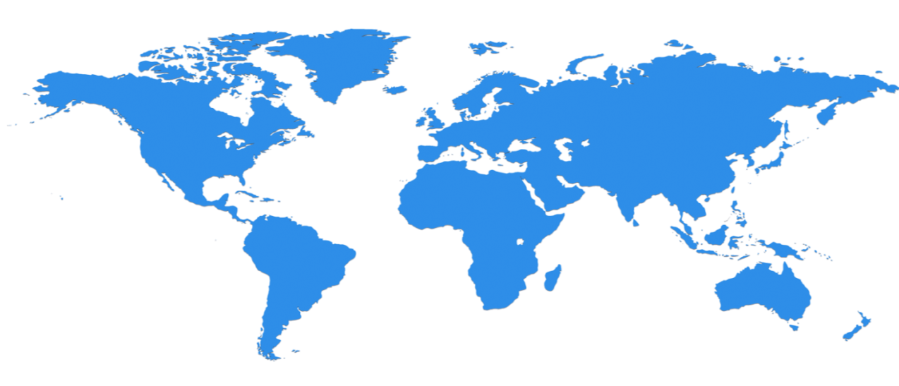

Huge infrastructure scale is the enabler
24 Regions Worldwide…huge capacity around the world…growing every year
UK
North Central US
Illinois
Germany
North Europe
Ireland
West Europe
Netherlands
Central US
Iowa
Canada Central
Toronto
Canada East
Quebec City
US Gov
Iowa
China North *
Beijing
China South *
Shanghai
Japan East
Saitama
West US
California
East US
Virginia
India Central
Pune
Japan West
Osaka
South Central US
Texas
East US 2
Virginia
US Gov
Virginia
India South
Chennai
India West
Mumbai
East Asia
Hong Kong
SE Asia
Singapore
Australia East
New South Wales
Brazil South
Sao Paulo
Australia South East
Victoria
100+ datacenters
Top 3 networks in the world
2x AWS, 6x Google DC Regions
G Series – Largest VM in World, 32 cores, 448GB Ram, SSD…
Operational
Announced/Not Operational
* Operated by 21Vianet

Slide 12
Azure momentum
~100,000
New Azure customer subscriptions/month
20 Million
SQL database hours used every day
>50 Trillion
Storage objects in Azure
>5 Trillion
Storage transactions every month
425 Million
Azure Active Directory Users
60 Billion
Hits to Websites run on Azure Web App Service
57%
Of Fortune 500 Companies use Microsoft Azure
1 Trillion
Messages delivered every month with Event Hubs

Slide 13

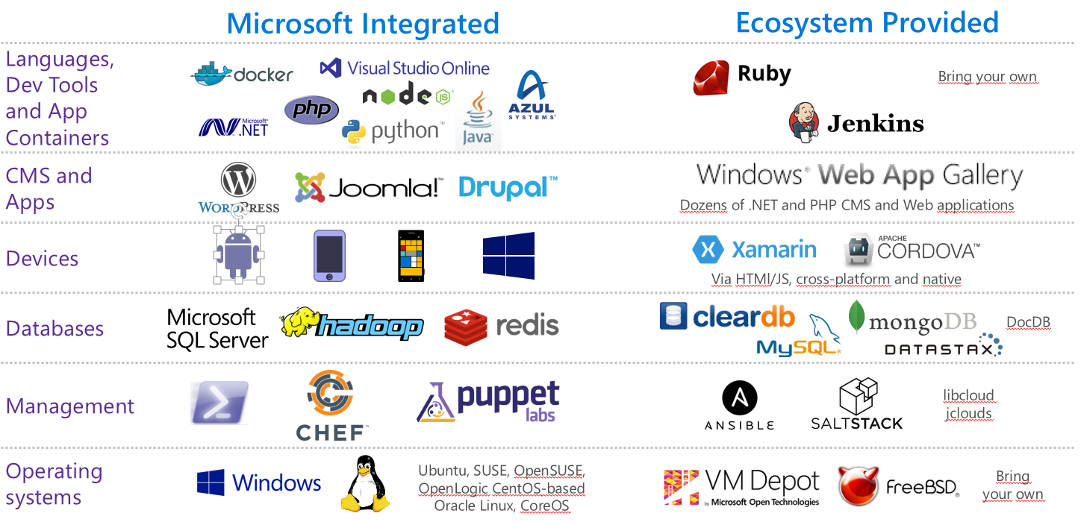
OPEN - Azure is an Open Cloud
Microsoft is an active and mature participant & contributor to OSS projects
Broad OSS ecosystem in Azure marketplace and validated/curated by Microsoft
Visual Studio 2015 are supporting developers not running our platform
> 20% of Azure deployments are on Linux

Slide 14




















































Platform Services
Security & Management
Compute
Web and Mobile
Developer Services
Hybrid
Operations
Cloud
Services
Service
Fabric
Web Apps
API
Apps
API
Management
Visual Studio
Azure SDK
Portal
Azure AD
Connect Health
Batch
Remote App
Mobile
Apps
Logic
Apps
Notification
Hubs
Team Project
Application
Insights
Active
Directory
AD Privileged
Identity
Management
Multi-Factor
Authentication
Integration
Analytics & IoT
Data
Backup
Storage
Queues
Biztalk
Services
Automation
HDInsight
Machine
Learning
SQL
Database
SQL Data
Warehouse
Operational
Insights
Hybrid
Connections
Service
Bus
Key Vault
Data
Factory
IoT and Event
Hubs
Redis
Cache
Search
Import/Export
Store /
Marketplace
Media & CDN
Site
Recovery
Stream
Analytics
Mobile
Engagement
DocumentDB
Tables
VM Image Gallery
& VM Depot
Media
Services
Content Delivery
Network (CDN)
StorSimple
Infrastructure Services
Compute
Storage
Networking
Virtual Machines
Containers
BLOB Storage
Azure Files
Premium Storage
Virtual Network
Load Balancer
DNS
Express
Route
Traffic Manager
VPN Gateway
Application Gateway
Datacenter Infrastructure (24 Regions, 19 Online)

Slide 15
Cloud choices – IaaS and PaaS Where to put the development effort?
“Hosting Models”
“Business Model”
Infrastructure
(as a Service)
Platform
(as a Service)
Software
(as a Service)
On Premises
Applications
Applications
You manage
Applications
Applications
You scale, make resilient and manage
You scale, make
resilient & manage
Data
Data
Data
Data
Runtime
Runtime
Runtime
Runtime
Scale, Resilience and management by vendor
Middleware
Middleware
Middleware
Scale, Resilience and management by vendor
Middleware
O/S
O/S
O/S
O/S
Virtualization
Virtualization
Managed by vendor
Virtualization
Virtualization
Servers
Servers
Servers
Servers
Storage
Storage
Storage
Storage
Networking
Networking
Networking
Networking

Slide 16
Two really popular PaaS offerings for ISVs
App Services
Data
Web Apps
Web Jobs
SQL
Database

Slide 17
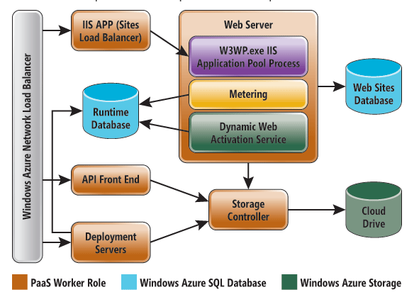
“Web sites as a service”
App Service is a cloud platform to build powerful web and mobile apps that connect to data anywhere, in the cloud or on-premises

Slide 18
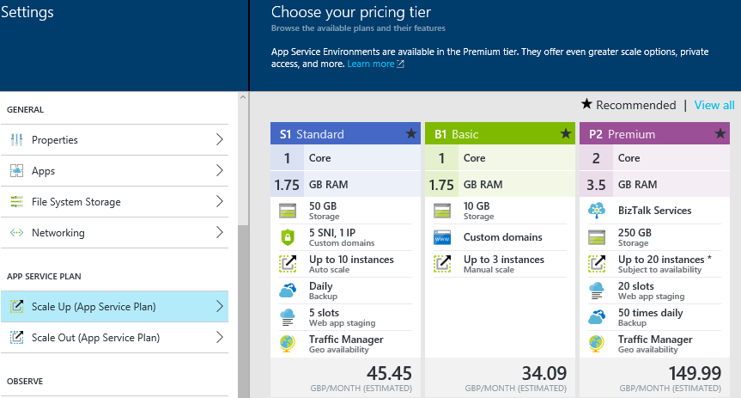
Azure App Services
Choose pricing tier

Slide 19
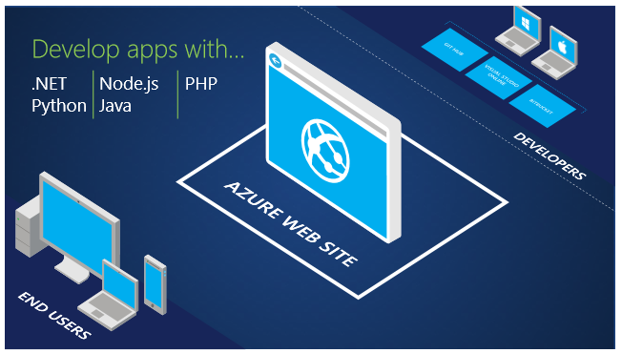
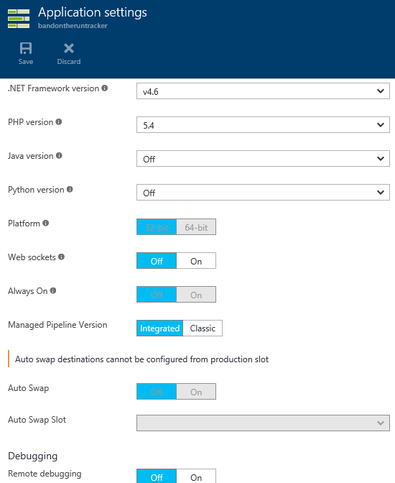
Azure App Services
Choose of dev languages

Slide 20
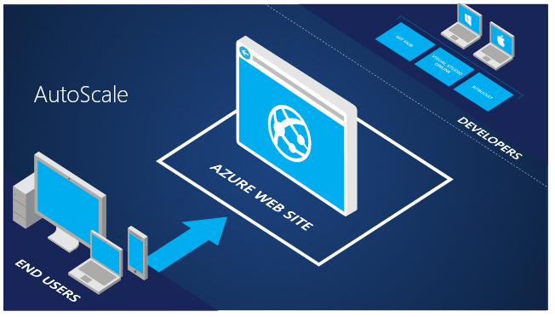
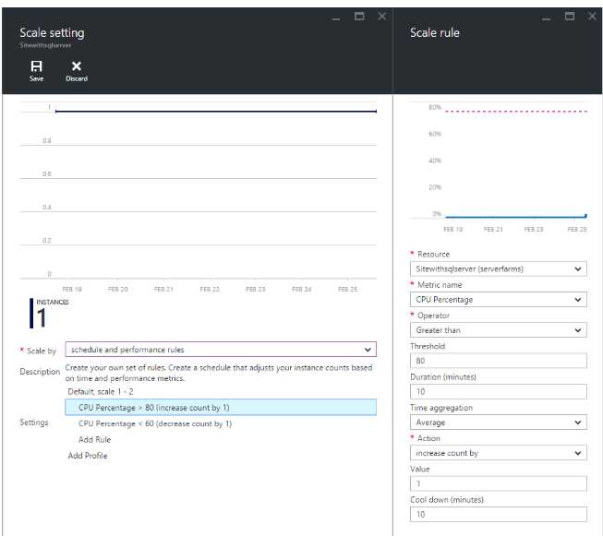
Azure App Services
Auto scale

Slide 21
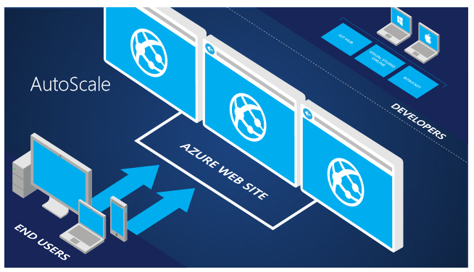
Azure App Services
Auto scale

Slide 22
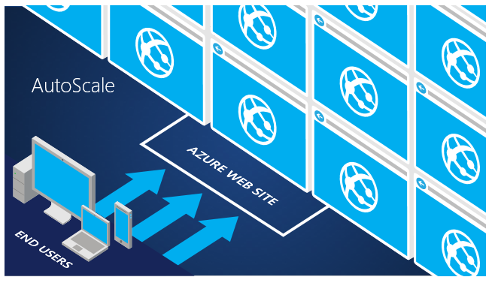
Azure App Services
Auto scale

Slide 23
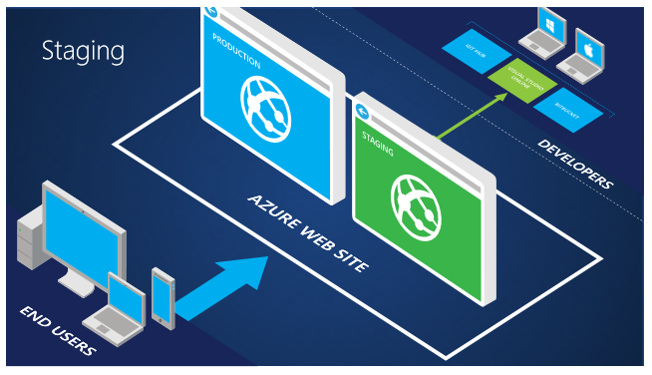
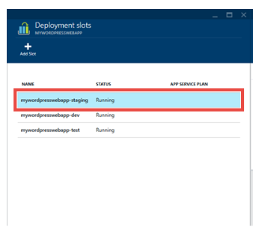
Azure App Services
Staging slots

Slide 24
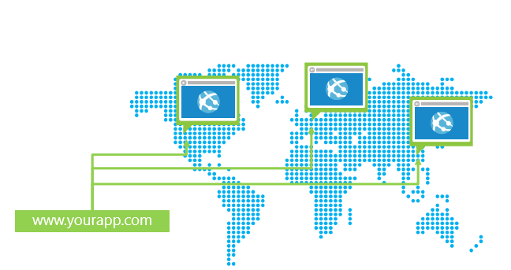
Azure App Services
Integration with Traffic Manager

Slide 25
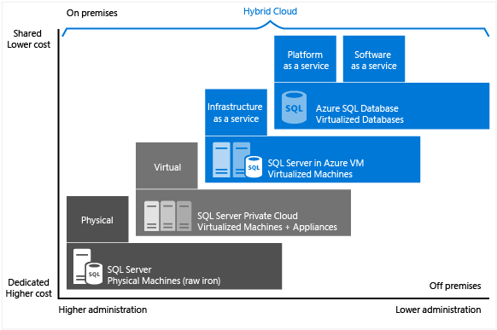
SQL Database (aka ‘SQL Azure’)

Slide 26
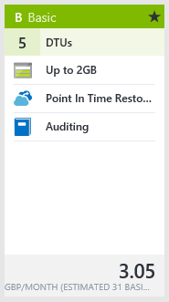
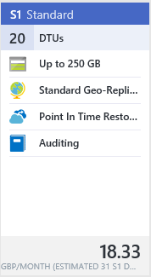
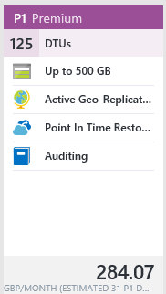
SQL Database
Available in Basic, Standard, and Premium service tiers
Supports lightweight to heavyweight database workloads
Change the service tier manually or programmatically

Slide 27
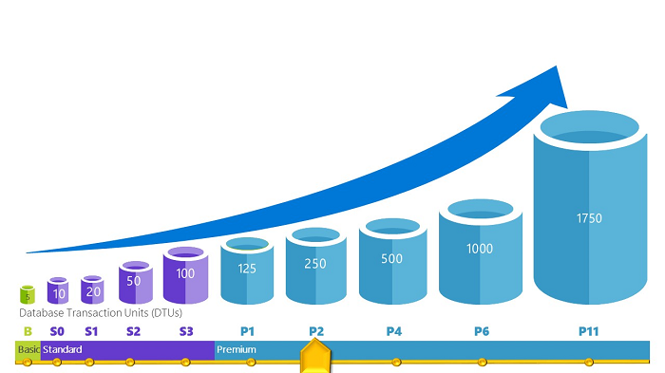
SQL Database
Database Transaction Unit (DTU) is unit of measure represents relative power databases
Each performance level provides increasing set of resources (‘power’) designed to deliver increasingly higher throughput.
Rating measured using the Azure SQL Database Benchmark (ASDB)

Slide 28
SQL Database

